Slide 1
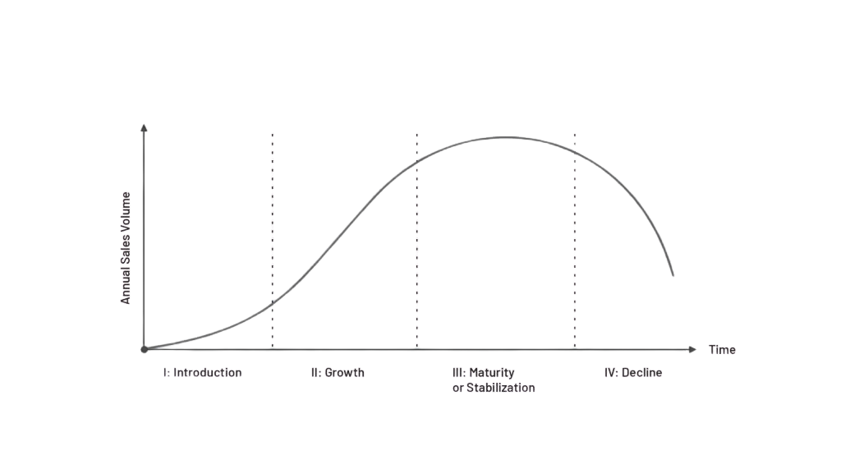




Product Life Cycle Analysis (PLC)
LoayDirar

Slide 2
Product Life Cycle Analysis (PLC)
PLC Stage | Typical Characteristics | Strategic Focus | Key Management Actions | BCG Matrix Relationship
Development Phase | Product under development, no revenues, high investment | Validate concept and feasibility | R&D investment, market testing, business case refinement | Not yet classified
Introduction Phase | Low sales, high costs, limited market awareness | Build awareness and market entry | Marketing investment, pricing strategy, channel setup | Question Mark (low market share, high growth potential)
Growth Phase | Rapid sales growth, improving margins, increasing competition | Scale and capture market share | Capacity expansion, differentiation, customer acquisition | Star (high growth, high market share)
Maturity & Saturation Phase | Sales peak, slower growth, strong cash generation | Maximize profitability and defend position | Cost optimization, economy of scale efficiency gains, product extensions | Cash Cow (low growth, high market share)
Decline Phase | Declining sales, margin pressure, reduced demand | Harvest, divest, or exit | Cost minimization, selective investment, discontinuation | Dog (low growth, low market share)
LoayDirar

